Slide 1
Deep Learning Stock Market Analysis
Eric Escareno
Christian Galleisky
Irvin Budwal
Joseph Lopez

Slide 2
What are we investigating? Why is it interesting?
Market psychology paired with deep learning can give us greater insight into how and when we should make trades. This is interesting to our group as most of us have very little investing experience so if novices can figure out how to leverage deep learning effectively there are many more possibilities.

Slide 3
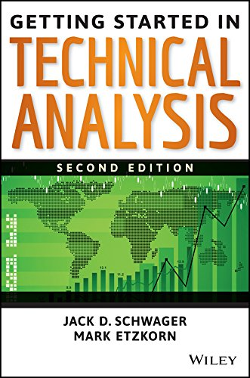
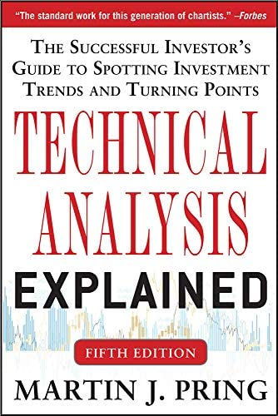
What reading will you examine to provide context and background?
Getting Started in Technical Analysis by Jack Schwager. Technical Analysis explained by Martin Pring. Both books give detail on technical analysis which can be used to make better predictions in stock price.

Slide 4
Data and Approach
Various APIs exist for trading stocks
Yahoo finance API appears to be a reliable/approachable choice (also free)
Though limited in options, may provide enough tools that we need
Alpha Vantage API also appears approachable and can code in python
May require payment for other premium features
Obtain large datasets to train our model:
https://www.kaggle.com/jacksoncrow/download-nasdaq-historical-data/notebook
We will try to get current data by either web scraping where possible or trying a script that collects the data.
https://www.kaggle.com/datasets/jacksoncrow/stock-market-dataset/discussion/188637
If we cannot find a means to quickly collect new data then we will use existing data to build upon.
Our model is meant to measure the emotional state of the market
Not just when to trade/take advantage of the market
Observe how the market feels about a certain share

Slide 5
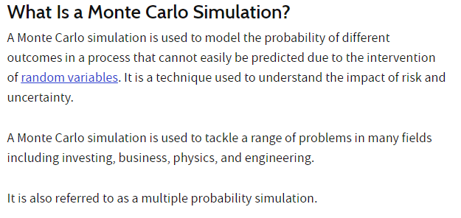
Method/Algorithm
https://www.investopedia.com/terms/m/montecarlosimulation.asp - The Monte Carlo Simulation
Notes:
https://www.kaggle.com/code/artemburenok/stock-analysis-monte-carlo-build-portfolio

Slide 6
How we build on the method? Metrics
There are existing implementations which we can build off of and tweak. Most likely this will require adding different forms of data to include as context. These can include:
Classical Economic indicators; capacity utilization, industrial production, inventories growth/contraction, unemployment rate, participation rate, savings rate, income growth rate, disposable income growth/contraction, etc…
Classical Business metrics: Price to earnings, price to earnings and growth, gross margin, operating income, Earnings before taxes interest and deductions (EBITDA), profit margin, Earnings per share, long term debt, assets, liabilities, assets minus liabilities, etc…
Classical stock chart ideas; shapes of stock price graphs and shapes of various stock chart metrics like RSI and Stochastic Oscillator, etc…

Slide 7
How will we evaluate our results?
We will evaluate our results by checking whether our model makes accurate predictions. We will need to learn technical analysis, which market psychology is an aspect of, to make our own predictions to compare against. Our results should be representable as plots and we should be able to compare the accuracy of our predictions across sample sizes to tweak our activation function. The ultimate goal would be to make the model as accurate as possible.

Slide 8
What drives market capitalization??
High quality products, new products, at the right price and right time!
Over time all products tend towards a homogenous price point. All companies sell for the same price, there is no more edge to make a profit on. Generic drugs are a perfect example of this.
Look at ETF like ‘QQQ’... Apple made up a massive majority of the shareholdings and subsequent capitalization as the price moved up.

Slide 9
Things to keep in mind while dealing with BUSINESS
Don’t chase losers into their grave. Cut your losses at small amounts and let your winners run up. Everyone makes mistakes. Move forward and head the lessons of the past.
The hope is that our market analysis model will help streamline the investment process by granting safeguards for users to maintain focus on spreads and trends.

Slide 10
Changes to our Project
Reduced focus on modeling “emotional state” of stocks/stock market
Decided to change approach from exclusively following current data, to older backlogs containing lengthier existing data so we can better make analysis

Slide 11
Data
Two data sets to choose from
Historical daily prices and volumes of all U.S. stocks and ETFs
Historical daily prices of Nasdaq-traded stocks and ETFs
First dataset is expansive, but only includes brute-force data up to year 2017
Second dataset is equally as expansive, but is more up to date
Latest update to dataset was in 2020
Provides data collection script and other tools to update dataset
Both sets are delimited files, easy to utilize within colab (CSV)

Slide 12
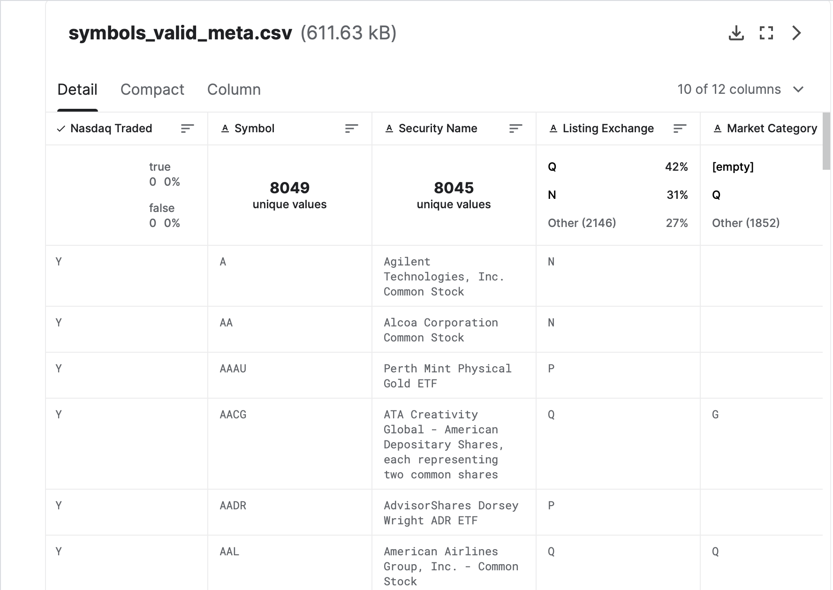
Data
Settled on “Historical daily prices of Nasdaq-traded stocks and ETFs”
Granular data set
Thorough documentation & structure
Quarterly update frequency
Easy to utilize and integrate

Slide 13
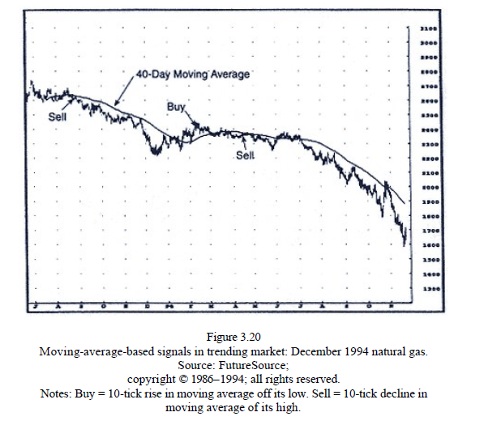
Technical Analysis
Moving averages can provide valuable insight when stocks are relatively stable.
Notes:
Page 48, Getting Started In Technical Analysis

Slide 14
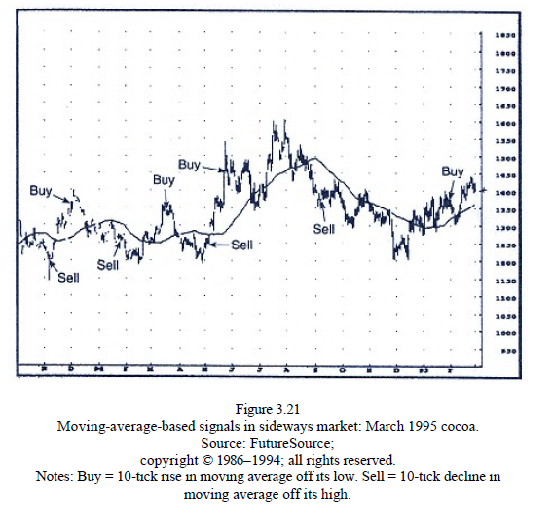
Technical Analysis
Moving averages can lead to poor predictions in an unstable stock price.

Slide 15
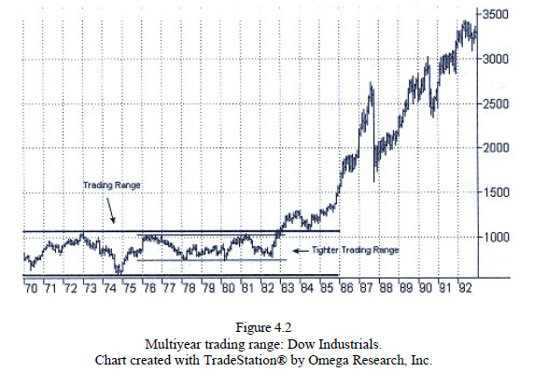
Technical Analysis
Trading ranges can be used to predict breakouts towards the side of the range where the initial breakout occurs. The longer the range means the more significant the breakout could become. Narrow ranges are more reliable.

Slide 16
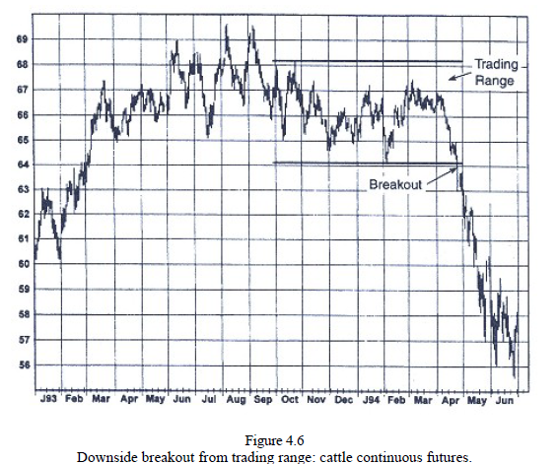
Technical Analysis
False breakouts also exist so it is important to be patient and wait for the stock to break its support or resistance.

Slide 17
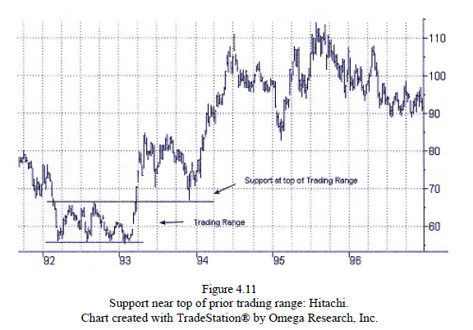
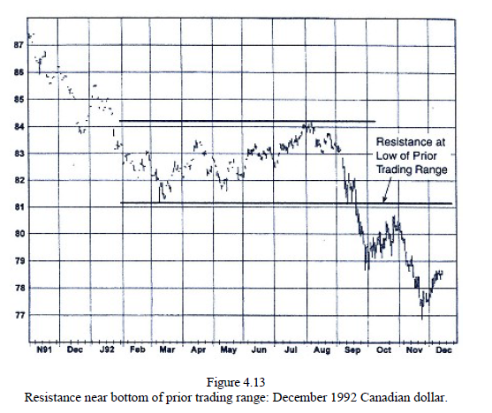
Technical Analysis

Slide 18
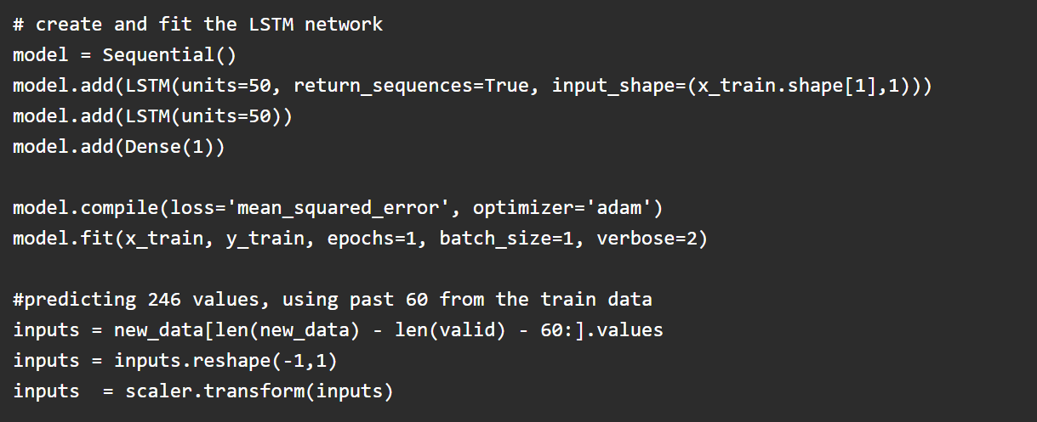
Related Works
https://www.analyticsvidhya.com/blog/2018/10/predicting-stock-price-machine-learningnd-deep-learning-techniques-python/
This project used different machine learning and deep learning models to try and make accurate stock predictions.
Notes:
https://www.analyticsvidhya.com/blog/2018/10/predicting-stock-price-machine-learningnd-deep-learning-techniques-python/
https://medium.datadriveninvestor.com/predicting-the-stock-market-with-python-bba3cf4c56ef
https://deepnote.com/@deepnote/Stock-Analysis-in-Python-4cf17a26-d9bd-420a-a356-74d668ece385
https://www.kaggle.com/code/thebrownviking20/intro-to-recurrent-neural-networks-lstm-gru/notebook
https://www.kaggle.com/code/artemburenok/stock-analysis-monte-carlo-build-portfolio/notebook

Slide 19
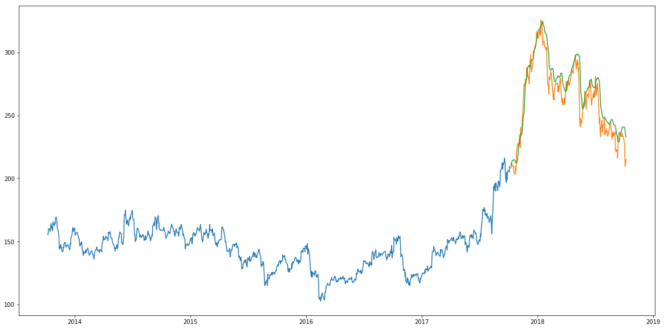
Related Works
LSTM model prediction graph:
Notes:
Orange line is the prediction.

Slide 20
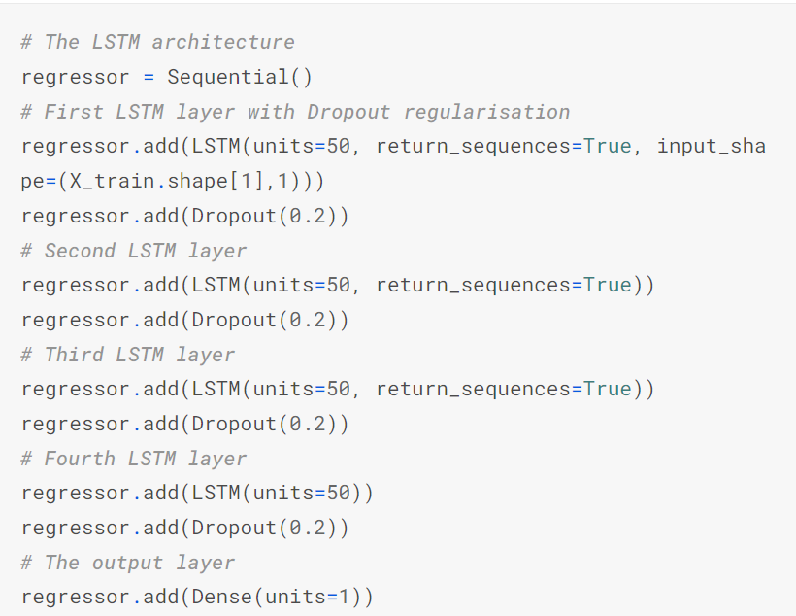
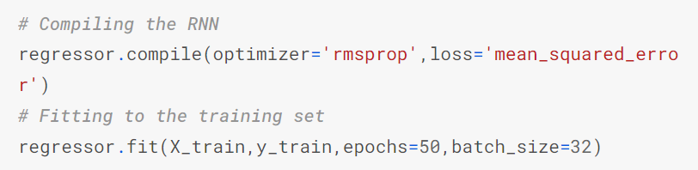
Related Works
https://www.kaggle.com/code/thebrownviking20/intro-to-recurrent-neural-networks-lstm-gru/notebook
This project showed an introduction to using LSTM’s to predict stock movement.

Slide 21
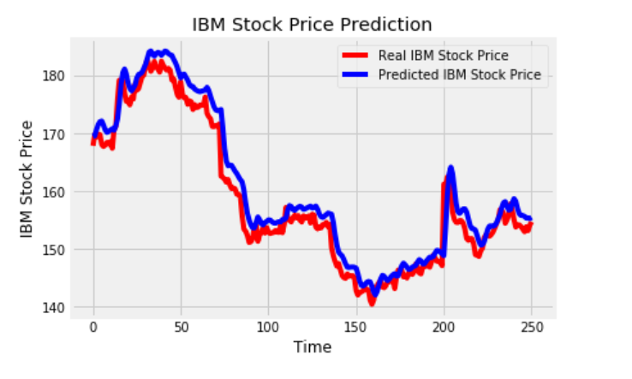
Related Works
LSTM model prediction graph:

Slide 22
Group Plan for Final Deliverables
Abstract: Irvin
Introduction: Chris, Eric, Joe, Irvin
Related works research: Eric
Data and processing: Chris, Eric, Joe
Methods/approach: Eric, Irvin
Experiments: Chris
Conclusion: Joe

Slide 23
Any Questions?

